Slide 1
Gateway to Generalized Linear Models: Logistic Regression
Advanced Data Analysis
2/19/20

Slide 2
Lecture Outline
Introduction to Generalized Linear Models
History
Types of GLMs
Link functions
The logistic model
Issues with the linear model
Research questions and hypotheses
Model fit
Hypothesis testing
Assumptions
Interpreting results

Slide 3
Learning Objectives
1. Understand what generalized linear models are
2. Understand the usage of logistic models
3. Estimating logistic models in R

Slide 4
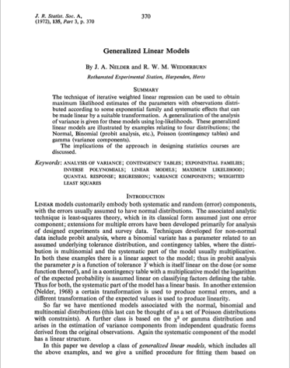
Generalized Linear Models (GLM)
GLM is an umbrella term for a collection of models
An iterative weighted least squares algorithm is used to estimate parameters
This approach was first developed by John Nedder and R. Wedderburn in 1972.

Slide 5
Several models fall under the family of GLMs
Logistic
Binary outcome (0/1 variable)
Example : Healthy or Sick, Dead or Alive
Ordinal logistic
Ordinal outcome (ordered with more than 2 levels)
Example: Likert-type scales – agreement, frequency
Multinomial logistic
Categorical outcome with more than two levels and not ordered
Tobacco usage – smoking, chewing tobacco, e-cigarettes, snuff
Poisson and negative binomial models
Count outcome
Cancer cases, crime events, number of grammy’s for a singer

Slide 6

Every GLM has a link function
A link function “linearizes” the relationship between fitted values and input variables when distributions other than normal are present.

Slide 7
The Linear Probability Model
It is possible to model a binary outcome using a linear model – the linear probability model.
Identical to a traditional linear model, but the outcome can only take the values of 1, when an event occurs, or 0, when it does not.
In this model, the expected value of y is the probability that y = 1 given x.
The coefficients are interpreted as: a unit change in x results in a probability change of β in y. The model is linear in the probability.

Slide 8
Issues with using linear regression
Heteroskedasticity
Because the variance of errors depends on x, it is not constant.
Violation of this assumption of OLS results in biased standard errors and incorrect results for hypothesis testing
Normality
Errors are not normally distributed because y can only take the values of 0 and 1.
Unintuitive Predictions
Estimates can be negative or >1.
Given the conceptualization of the fitted value being the probability that y=1, values might not make sense.
Functional Form
In many cases, the constant change of β in the probability of an event is unrealistic.

Slide 9
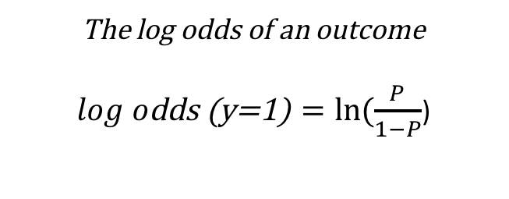
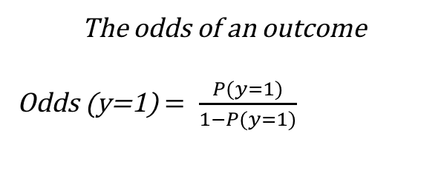
The Logistic Model
Estimates parameters given a binary outcome.
These estimates tell us how much the natural logarithm of the odds for y = 1 change for each one-unit change in x.
The natural log of the odds for y = 1 comes from a transformation of the probability into odds, which is the ratio of the probability that y = 1 to the probability that y = 0, and then taking the natural log of these odds to generate a linear function.
The odds of an outcome
Odds (y=1) $= \frac{P(y=1)}{1−P(y=1)}$
The log odds of an outcome
$log o\text{dds}\text{ (}\text{y}\text{=1)}=ln⁡(\frac{P}{1−P}$)

Slide 10
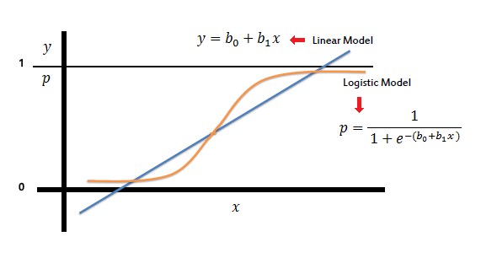
The Logistic Model Statement
Notes:
Work on this slide explanation. Add proof for this slide. Log odds is not constrained beteen 0 and 1…

Slide 11
Research questions and hypotheses
What research questions can a logistic model answer?
Does age onset of smoking and gender predict the probability of using heroine?
Does age, ethnicity, and BMI influence the likelihood of being diagnosed with heart disease?
What hypotheses can be posed for heroine usage?
H₀: The probability of using heroine is not associated with age onset of smoking.
H_{a}: The probability of using heroine is associated with age onset of smoking.
What hypotheses can be posed for heart disease?
H₀: The probability of having heart disease is not associated with BMI.
H_{a}: The probability of having heart disease is associated with BMI.

Slide 12
Model Fit for Logistic Model
Log-likelihood is one of the primary statistics that describes model fit. It is a measure of the unexplained variation in the fitted model.
The log likelihood is calculated by summing the difference in probability between the predicted and observed outcome, similar to the sum of squares in linear regression.
Larger log-likelihood values indicate a poor fit to the model because these values suggest many predicted values are far from their observed values.
The deviance statistic, another measure of model fit, is calculated by -2 * log-likelihood.

Slide 13
Model Fit for Logistic Model
In logistic regression, there is no linear regression-like R² due to differences in estimated coefficients
In linear regression, estimates are calculated by ordinary least squares and in logistic regression, estimates are calculated by maximum likelihood.
Pseudo R²’s have been developed to provide a similar applicable concept to logistic models, but these are calculated differently. For more information on these see:
https://stats.idre.ucla.edu/other/mult-pkg/faq/general/faq-what-are-pseudo-r-squareds/
https://statisticalhorizons.com/r2logistic

Slide 14
Model Fit for Logistic Model
Sensitivity and Specificity provide a measure of how accurately your model classifies individuals with respect to the outcome
 |  | Actual data
Model Predicted |  | 1 | 0
 | 1 | a | b
 | 0 | c | d
Model Sensitivity = a/(a+c)
Model Specificity = d/(d+b)

Slide 15
Hypothesis Testing
Parameters in a logistic model are estimated using maximum likelihood estimation.
The estimated values of these parameters (the β’s) are those that maximize the log likelihood function
Put another way, the parameters are chosen so that the likelihood that the process described by the model produced by the data actually observed is maximized

Slide 16
Hypothesis Testing
The common hypothesis test for a predictor in a logistic model is the Wald test.
It is a hypothesis test with the null hypothesis that one or more predictors are equal to 0.
The calculated statistic is similar to the t statistic, but one difference is the Wald test can be calculated for multiple variables at once.

Slide 17
Assumptions for Logistic Regression
Most of the linear regression model assumptions do not apply to logistic regression, however, there are still assumptions to be tested.
Design
Binary dependent variable
Independence of observations
Adequate sample size
Data
Linear relationship between input variable and log odds of outcome variable
No multicollinearity

Slide 18
Testing Assumptions
To test the two data assumptions, that is linearity and multicollinearity, a Box Tidwell test and an examination of Variance Inflation Factors can be conducted.
The Box Tidwell transformation – an interaction term for each input variable with its natural log is added to the model. A non-significant estimate indicates no violation of linearity.
Variance inflation factors – each input variable is regressed on all other input variables to obtain an R² and the VIF is calculated using the formula, 1/1-R²(x₁). Several cutoffs are suggested including 4, 5, and 10, in which values greater than those indicate multicollinearity problems.

Slide 19
Interpreting Results
The coefficients resulting from model estimation provide information about the relationship between the predictor variable and the log odds of the outcome variable.
This interpretation of the coefficient is not very intuitive, although you can tell significance and direction of the relationships from the coefficient.
Odds ratios are typically used in public health for interpretation

Slide 20
Interpreting Results
Odds ratios are calculated by exponentiating the beta estimates
Odds ratios > 1 are interpreted as an increase in the odds given a unit change in x.
Odds ratios < 1 are interpreted as a decrease in the odds given a unit change in x.
These can be reported as an odds change (OR = 2, 2 times greater odds) or a percentage change (OR = 1.20, 20% more likely).

Slide 21
Interpreting Results
Marginal effects are the partial change in the probability of the outcome given a predictor variable.
Marginal effects are measures of the slope of the probability curve for one predictor variable, holding the others constant.
A commonly used marginal effect is average marginal effect, which is the marginal effects averaged over all observations.
Marginal effects can also be calculated at the mean and for specific cases imposed by the analyst.
Not used very often in public health

Slide 22
In class demo
Download the Class 6_demo.Rmd from Canvas or Github, and let’s try it!

